Slide 1
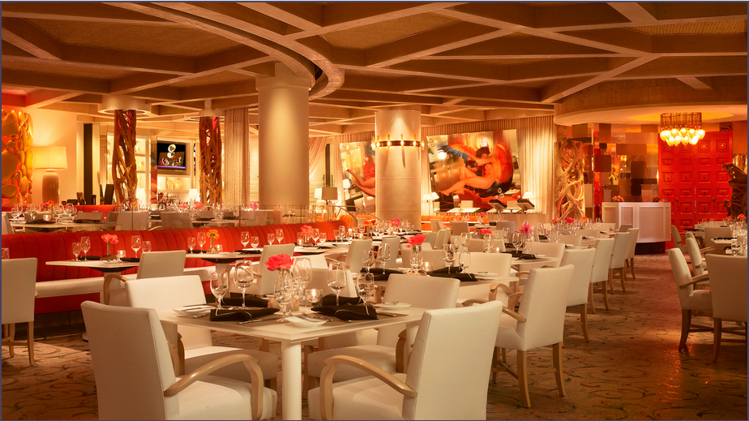
Minimally Viable Product for Restaurant Inspections Prediction
Aurelie Jodelle Kemme

Slide 2




AIMS Cameroon: Master’s Degree in Industrial Mathematics 2019/2021
Quantum Leap Africa: Research Master in Data Science 2022
Software Developer at CAPC_AC 2020
Data Science Fellow at Ishango.ai 2021
Loves jogging
Aurelie Jodelle Kemme

Slide 3
Data Exploration
TRAIN_SET_2021.csv (27 columns)
TEST_SET_2021.csv (26 columns)
RESTAURANT SERIAL NUMBER (15’673)
NEXT INSPECTION GRADE C OR BELOW
INSPECTION DEMERITS
MEDIAN EMPLOYEE AGE
RESTAURANT SERIAL NUMBER (7’505)
???
INSPECTION DEMERITS
MEDIAN EMPLOYEE AGE

Slide 4
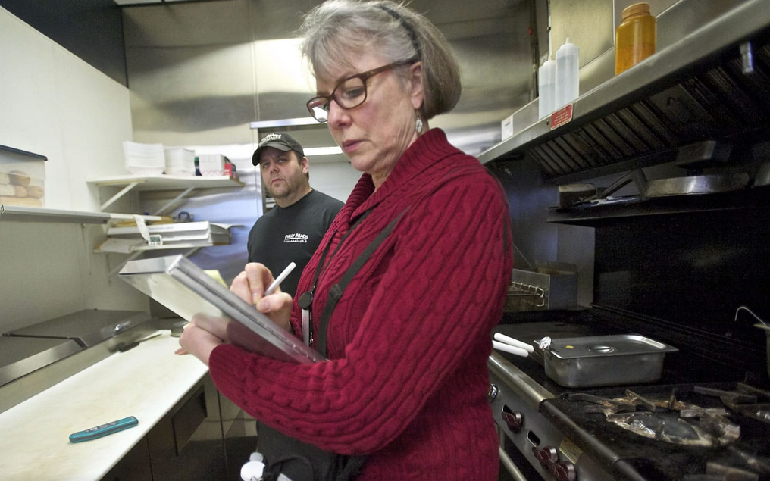
Problem
Can we build a workable MVP model to predict next inspections grade ?
Notes:
Bring in the netflix example, youtube

Slide 5

Data cleaning
Drop rows with NaN values
Drop rows with values considered as noises
Convert some features
Data Processing
Correlation matrix
Using the pearson measure
Notes:
NUMBER_OF_VIOLATIONS (Nevada), INSPECTION_DEMERITS(Routine Inspection), NEXT_INSPECTION_GRADE_C_OR_BELOW

Slide 6
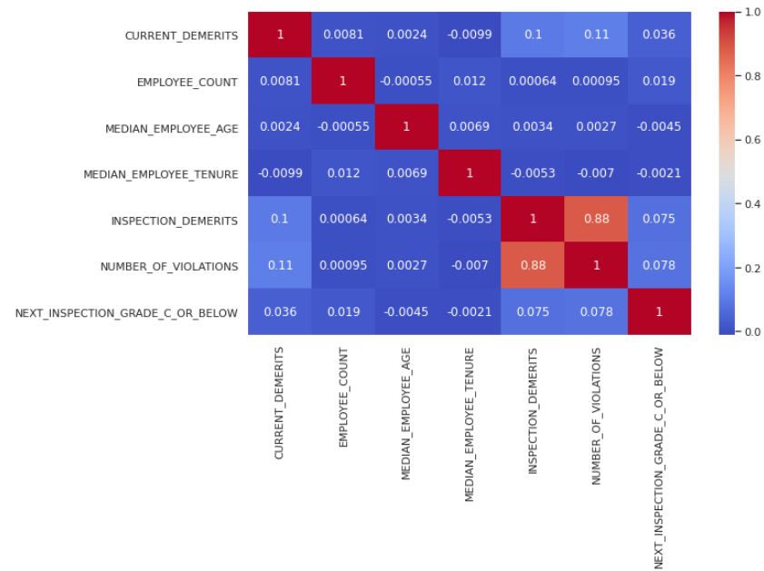
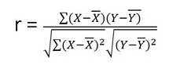
Pearson Similarity

Slide 7
Standardization
Z-score
Data Processing
Binarization
Categorical variables
Notes:
It is not our concern to think about special conditions in the dogs: such as allergies, joint issues, or price of the products

Slide 8

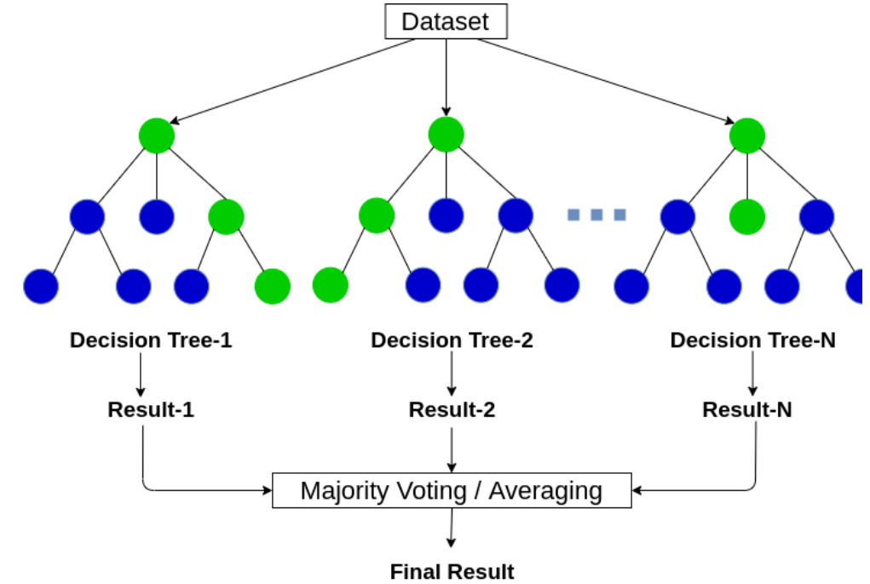
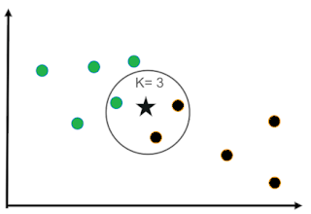
Methods
K- Nearest Neighbours
Logistic Regression
Random Forest

Slide 9
Accuracy
Model | RMSE | Accuracy: % Train set | Accuracy: % Test set
Logistic Regression | 0.391 | 83.77% | 84.67%
Random Forest | 0.394 | 99.99% | 84.36%
KNN | 0.411 | 84.61% | 83.05%

Slide 10
Re-sample the data using oversampling or undersampling
Collect data with both class
zero and one
Recommendation
Provide more information on the violation raw
Good description about forms of violation may help

Slide 11


Thank you
jodelle.kemme@aims-cameroon.org

Slide 12

Questions ?

